Slide 1
Does a team with a better passing offense or rushing offense have an advantage?

Slide 2
Hypotheses for Statistical Tests
Ho: Proportion of wins for the team with a passing YPG advantage is 0.50 (P=0.5)
Ha: Proportion of wins for the team with a passing YPG advantage is different than 0.50 (P =! 0.5)
Ho: Proportion of wins for the team with a rushing YPG advantage is 0.50 (P=0.5)
Ha: Proportion of wins for the team with a rushing YPG advantage is different than 0.50 (P =! 0.5)
Ho: Proportion of wins for the team with more passing attempts is 0.50 (P=0.5)
Ha: Proportion of wins for the team with more passing attempts is different than 0.50 (P =! 0.5)
Ho: Proportion of wins for the team with more rushing attempts is 0.50 (P=0.5)
Ha: Proportion of wins for the team with more rushing attempts is different than 0.50 (P =! 0.5)
Ho: Proportion of wins for the team with a higher QBR is 0.50 (P=0.5)
Ha: Proportion of wins for the team with a higher QBR is different than 0.50 (P =! 0.5)

Slide 3
Variables for Hypothesis Testing and Regression
Each of these 6 variables are binary, meaning they either have a 0 that indicates team 1 or a 1 that indicates team 2. The rows of data represent all NFL games played from the 2002 season through the 2016 season. Each row represents one game.
result1 – Indicates which team won the game
passingAtt_Adv – Indicates which team had more total passing attempts in the season during which the game was played.
passingYdsG_Adv – Indicates which team had more passing yards per game in the season during which the game was played.
passingQBR_Adv – Indicates which team had a higher QBR in the season during which the game was played.
rushingAtt_Adv – Indicates which team had more rushing attempts in the season during which the game was played.
rushingYdsG_Adv – Indicates which team had more rushing yards per game in the season during which the game was played.

Slide 4
Reasons for Variable Selection
result1 is needed to determine the winner of the game.
passingAtt_Adv and rushingAtt_Adv were used to help answer the question of whether teams who pass or rush more win more often.
passingYdsG_Adv and rushingYdsG_Adv were used since they give an easily interpretable value. Passing and Rushing offense ranks are normally obtained by total yards. Yards per game ranks would be the same as total passing and rushing offense ranks.
passingQBR_Adv – QBR is a statistic that considers several aspects of passing (touchdowns, interceptions, yards, etc.). Therefore it will tell us whether the more efficient passing offense is better.

Slide 5
Variables for Further Analysis
I also selected extra variables in order to complete other portions of the assignment outside of my statistical hypotheses.
winRushingRank - Contains values of 1-32 for the rank of the winning team’s rushing offense in the season the game was played.
winPassingRank - Contains values of 1-32 for the rank of the winning team’s passing offense in the season the game was played.
totteam1_Adv – Contains values 0-5 indicating the number of advantages team number 1 had in the game.
totteam2_Adv – Contains values 0-5 indicating the number of advantages team number 2 had in the game.
passingYPG – Contains numerical values indicating number of passing yards per game for every team between 2002-2016.
rushingYPG - Contains numerical values indicating number of rushing yards per game for every team between 2002-2016.

Slide 6
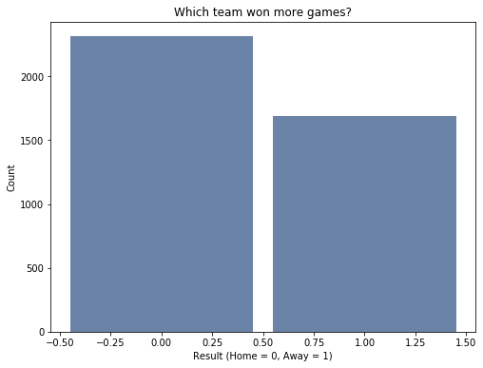
Histogram - result1
Mean: 0.422
Median: 0
Mode: 0
A histogram of the result1 variable indicates that team 0, which is the home team, won 57.8% of the games from 2002-2016.

Slide 7
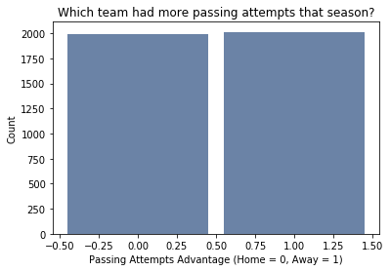
Histogram - passingAtt_Adv
Mean: 0.503
Median: 1
Mode: 1
A histogram of the passingAtt_Adv variable indicates that team 1, which is the away team, had a passing attempts advantage for 50.3% of the games from 2002-2016.

Slide 8
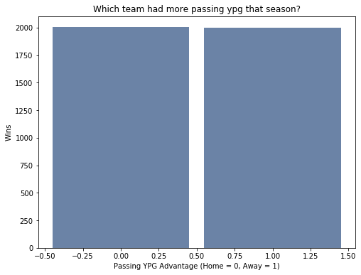
Histogram - passingYdsG_Adv
Mean: 0.499625
Median: 0
Mode: 0
A histogram of the passingYdsG_Adv variable indicates that team 0, which is the home team, had a passing yards per game advantage for 50.0375% of the games from 2002-2016.

Slide 9
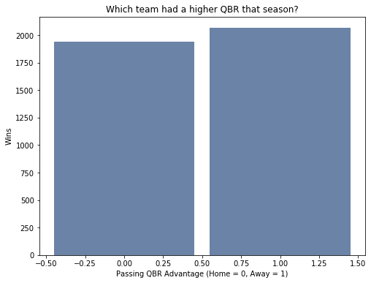
Histogram - passingQBR_Adv
Mean: 0.515605
Median: 1
Mode: 1
A histogram of the passingQBR_Adv variable indicates that team 1, which is the away team, had a passing quarter back rating advantage for 51.5605% of the games from 2002-2016.

Slide 10
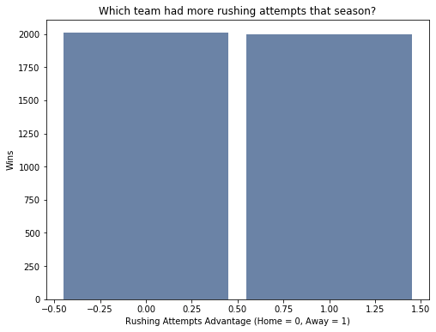
Histogram - rushingAtt_Adv
Mean: 0.498
Median: 0
Mode: 0
A histogram of the rushingAtt_Adv variable indicates that team 0, which is the home team, had a rushing attempts advantage for 50.16% of the games from 2002-2016.

Slide 11

Histogram - rushingYdsG_Adv
Mean: 0.498
Median: 0
Mode: 0
A histogram of the rushingYdsG_Adv variable indicates that team 0, which is the home team, had a rushing yards per game advantage for 50.18% of the games from 2002-2016.

Slide 12
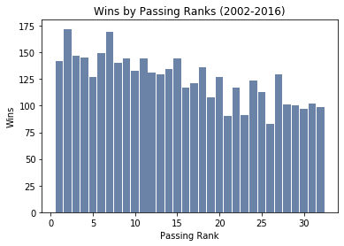
Histogram - winPassingRank
Mean: 15.1735
Median: 14
Mode: 2
Variance: 83.74
Standard Deviation: 9.15
This histogram represents the number of wins for each passing rank (ex. Teams that ended the season ranked number 2 in passing won 172 games from 2002-2016). There seems to be a somewhat linear relationship between Passing Rank and count/wins where the higher the rank, the more wins the team got. There are a few unexpected bars that don’t follow the trend such as rank 27 which had 129 wins, which is between rank 26 with 83 wins and rank 28 with 101 wins.

Slide 13
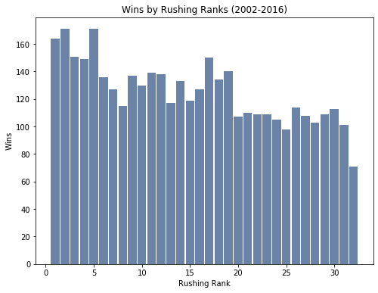
Histogram - winRushingRank
Mean: 15.1356
Median: 15
Mode: 2 and 5
Variance: 83.97
Standard Deviation: 9.16
This histogram represents the number of wins for each rushing rank (ex. Teams that ended the season ranked number 1 in passing won 164 games from 2002-2016). There seems to be a somewhat linear relationship between rushing rank comparable to passing rank. Furthermore, their standard deviations are almost the same; only off by 0.01. There are a few unexpected bars that don’t follow the trend such as rank 5 which tied for the most wins with rank 2 at 171.

Slide 14
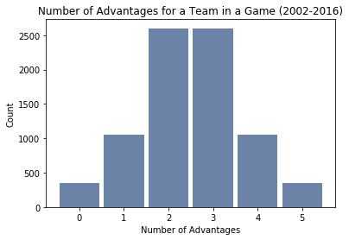
Histogram - totteam1_Adv + totteam2_Adv
Mean: 2.5
Median: 2.5 (central 2 observations were 2 and 3)
Mode: 2 and 3
Variance: 1.298
Standard Deviation: 1.139
This histogram represents the distribution of number of advantages for a team in each gave between 2002-2016 considering the main 5 advantages mentioned previously. This is a normal, perfectly symmetrical distribution where 0 and 5, 1 and 4, and 2 and 3 have the same frequencies. To interpret this graph, most commonly teams from 2002-2016 had either 2 or 3 advantages in a game. This supports the idea that a complete mismatch does not happen most of the time since teams had either 2/5 or 3/5 advantages 65% of the time from 2002-2016.

Slide 15
Wins by Passing Rank – Split by Year
The histogram and PMFs for number of wins for each passing rank split by years can be found on the next slide. I picked the first three seasons and the most recent three seasons from the dataset. There is an alleged trend in the game where the NFL is become more of a passing league. From the graph we can see some differences in the proportions of wins. It appears lower ranked passing teams got more wins in the early 2000s compared to more recent years.

Slide 16
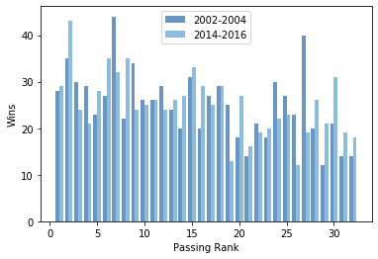
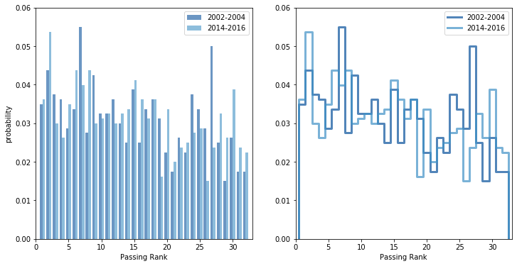
Wins by Passing Rank – Split by Year
Histogram
PMFs

Slide 17
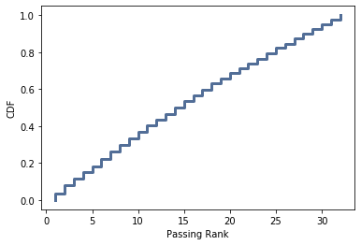
CDF – Wins by Passing Rank
This plot shows us that the proportion of wins by Passing Rank doesn't vary too much. In other words, a team with a particular Passing Rank does not win a considerable amount of time more often than the others.

Slide 18
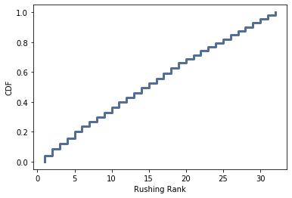
CDF – Wins by Rushing Rank
This plot shows us that the proportion of wins by Rushing Rank doesn't vary too much either. In other words, a team with a particular Rushing Rank does not win a considerable amount of time more often than the others.

Slide 19
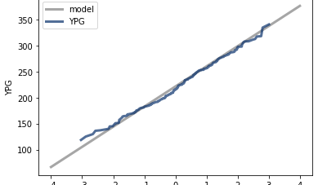
Normal Probability Plot – Passing YPG
The plot for passing YPG for each team between 2002-2006 appears to be a normal distribution. The data is close to the perfect normal model (grey line). In other words, we could expect 95 percent of the teams to have passing yards per game that fall within 2 standard deviations of the mean. With a mean of 221.26 and std of 38.65, this would be between 143.96 and 298.56.

Slide 20
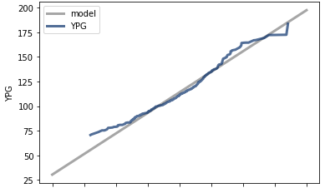
Normal Probability Plot – Rushing YPG
The plot for rushing YPG does not seem to be as normally distributed as passing YPG. This plot seems to be more convex indicating a right skew. A right skew would mean that there were some teams that had much higher rushing YPG than the norm.

Slide 21
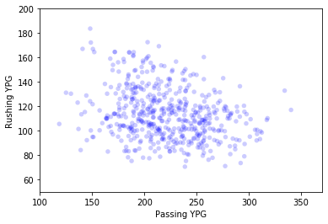
Correlation – Passing YPG and Rushing YPG
Pearson’s Correlation: -0.2663
There is very little correlation between passing yards per game and rushing yards per game. The little correlation seen is negative indicating that as Rushing YPG increase, Passing YPG decreases. However, it makes sense that the correlation is low because we often see examples of teams failing to set up their passing game because their rushing game is struggling. However, causation cannot be taken from the correlation. There are likely outside factors in this relationship.

Slide 22
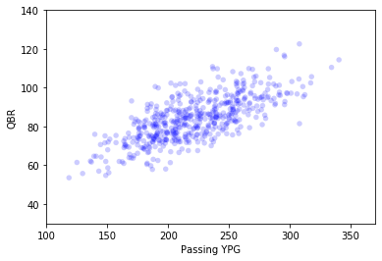
Correlation – Passing YPG and QBR
Pearson’s Correlation: 0.7167
For this relationship we see a moderately strong positive relationship. As QBR increases, Passing YPG increase. This is to be expected since better quarterback performance usually means they obtain more yards. Furthermore, yards are considered in the QBR formula. However, in practice, more yards per game does not always lead to a higher QBR. And vice versa, a higher QBR doesn’t always lead to more passing yards per game.

Slide 23
Hypothesis Testing
Statistical Advantage | Winning Percentage
Passing Attempts | 48.39%
Passing Yards Per Game | 57.78%
Quarterback Rating | 51.54%
Rushing Attempts | 60.40%
Rushing Yards Per Game | 57.63%
Using the data, I calculated the winning percentage for teams with an advantage in each of the 5 categories outlined previously. With this we see that teams that win more often run the ball more often. Teams that pass the ball more often, don’t win as often. That is to be expected as teams that are behind in a game pass more often than a team that is running the clock down to sustain a lead by rushing. Both passing YPG and Rushing YPG advantages are associated with more wins, which is also to be expected as they indicate better offensive performance. However, which of these are statistically significant?

Slide 24
Hypothesis Testing – Passing YPG
Ho: Proportion of wins for the team with a passing YPG advantage is 0.50 (P=0.5)
Ha: Proportion of wins for the team with a passing YPG advantage is different than 0.50 (P =! 0.5)
Result: I obtained a p value of 0 which tells me we would almost never expect a difference of 623 between wins and losses if the null hypothesis was true. Therefore, we reject the null hypothesis and accept the alternative hypothesis.

Slide 25
Hypothesis Testing – Passing Attempts
Ho: Proportion of wins for the team with a passing attempts advantage is 0.50 (P=0.5)
Ha: Proportion of wins for the team with a passing attempts advantage is different than 0.50 (P =! 0.5)
Result: I obtained a p value of 0.039 which tells we would expect a difference of 129 between wins and losses if the null hypothesis was true 3.9% of the time. Therefore, we reject the null hypothesis at alpha = 0.5 and accept the alternative hypothesis.

Slide 26
Hypothesis Testing – Quarterback Rating
Ho: Proportion of wins for the team with a quarterback rating advantage is 0.50 (P=0.5)
Ha: Proportion of wins for the team with a quarterback rating advantage is different than 0.50 (P =! 0.5)
Result: I obtained a p value of 0.056 which tells we would expect a difference of 123 between wins and losses if the null hypothesis was true 5.6% of the time. Therefore, we fail to reject the null hypothesis at alpha = 0.5.

Slide 27
Hypothesis Testing – Rushing Attempts
Ho: Proportion of wins for the team with a rushing attempts advantage is 0.50 (P=0.5)
Ha: Proportion of wins for the team with a quarterback rating advantage is different than 0.50 (P =! 0.5)
Result: I obtained a p value of 0 which tells we would almost never expect a difference of 833 between wins and losses if the null hypothesis was true. Therefore, we reject the null hypothesis at alpha = 0.5 and accept the alternative hypothesis.

Slide 28
Hypothesis Testing – Rushing YPG
Ho: Proportion of wins for the team with a rushing yards per game advantage is 0.50 (P=0.5)
Ha: Proportion of wins for the team with a quarterback rating advantage is different than 0.50 (P =! 0.5)
Result: I obtained a p value of 0 which tells we would almost never expect a difference of 611 between wins and losses if the null hypothesis was true. Therefore, we reject the null hypothesis at alpha = 0.5 and accept the alternative hypothesis.

Slide 29
Multiple Logistic Regression - Model
Passing Att | Passing YPG | QBR | Rushing Att | Rushing YPG | Win Probability
0 | 0 | 0 | 0 | 0 | 0.2155
1 | 1 | 1 | 1 | 1 | 0.6476
0 | 1 | 0 | 1 | 1 | 0.683
0 | 0 | 0 | 1 | 1 | 0.4403
1 | 1 | 1 | 0 | 0 | 0.3909
0 | 1 | 1 | 0 | 0 | 0.4554
Formula: result1 ~ passingAtt_Adv + passingYdsG_Adv + passingQBR_Adv + rushingAtt_Adv + rushingYdsG_Adv
This model predicts the probability of team 2 (away team) winning based on whether they have an advantage in any of the 5 categories.
1 = Team 2 has an advantage, 0 = Team 2 does not have an advantage
From the probabilities we see that simply having an advantage in passing alone or rushing alone does not give a team an advantage. The highest probability for winning came from different combinations of both passing and rushing advantages.

Slide 30
Multiple Logistic Regression - Evaluation
 |  | Actual
 |  | 1 | 0
Predicted | 1 | 525 | 297
 | 0 | 1167 | 2016
Accuracy: 63.45%
The model predicted the correct outcome 63.45% of the time
Precision: 63.87%
When the model predicted that team 2 would win, it was correct 63.87% of the time.
Recall: 31.03%
When team 2 did win, the model was able to predict it 31.03% of the time.
Limitations: This model was evaluated on the same data it was trained on. These scores may or may not represent how the model would perform on new data.

